Slide 1
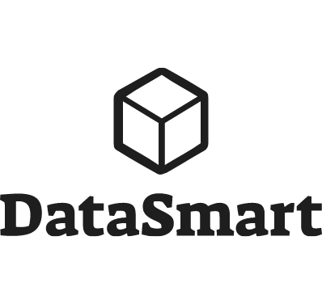



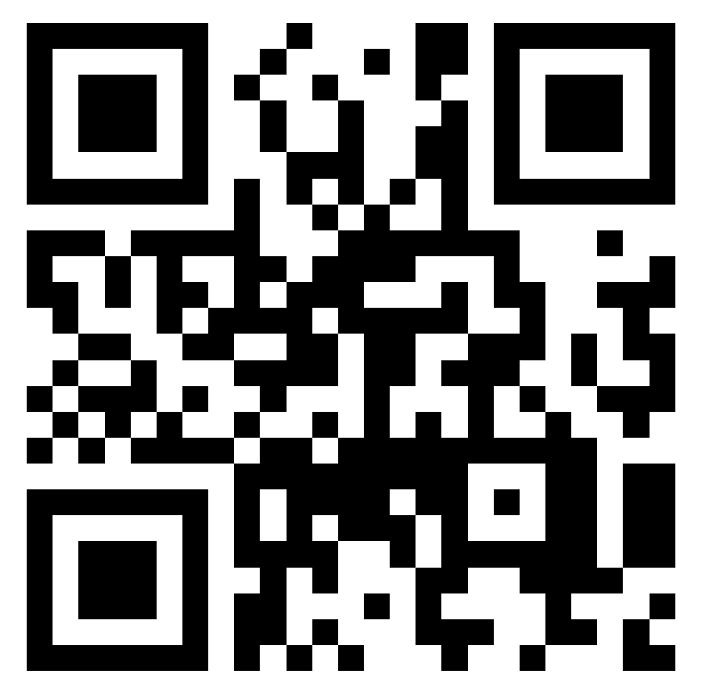
Avoiding Turbulent Skies: Power BI Security Strategies for a Smooth Flight
@MarkDataGuy
../in/markhayes/
datasmart.ie
Working with Data since 1999
Specialized in BI since OLAP Services in 2000
Co-Leader Cork User Groups & DataCeili
Regular Speaker on Data Platform Topics

Slide 2
What are we going to talk about
The Power BI Administrator
Tenant Settings
Data Gateways and Connections
Securing the Workspace and app
Securing the data model

Slide 3

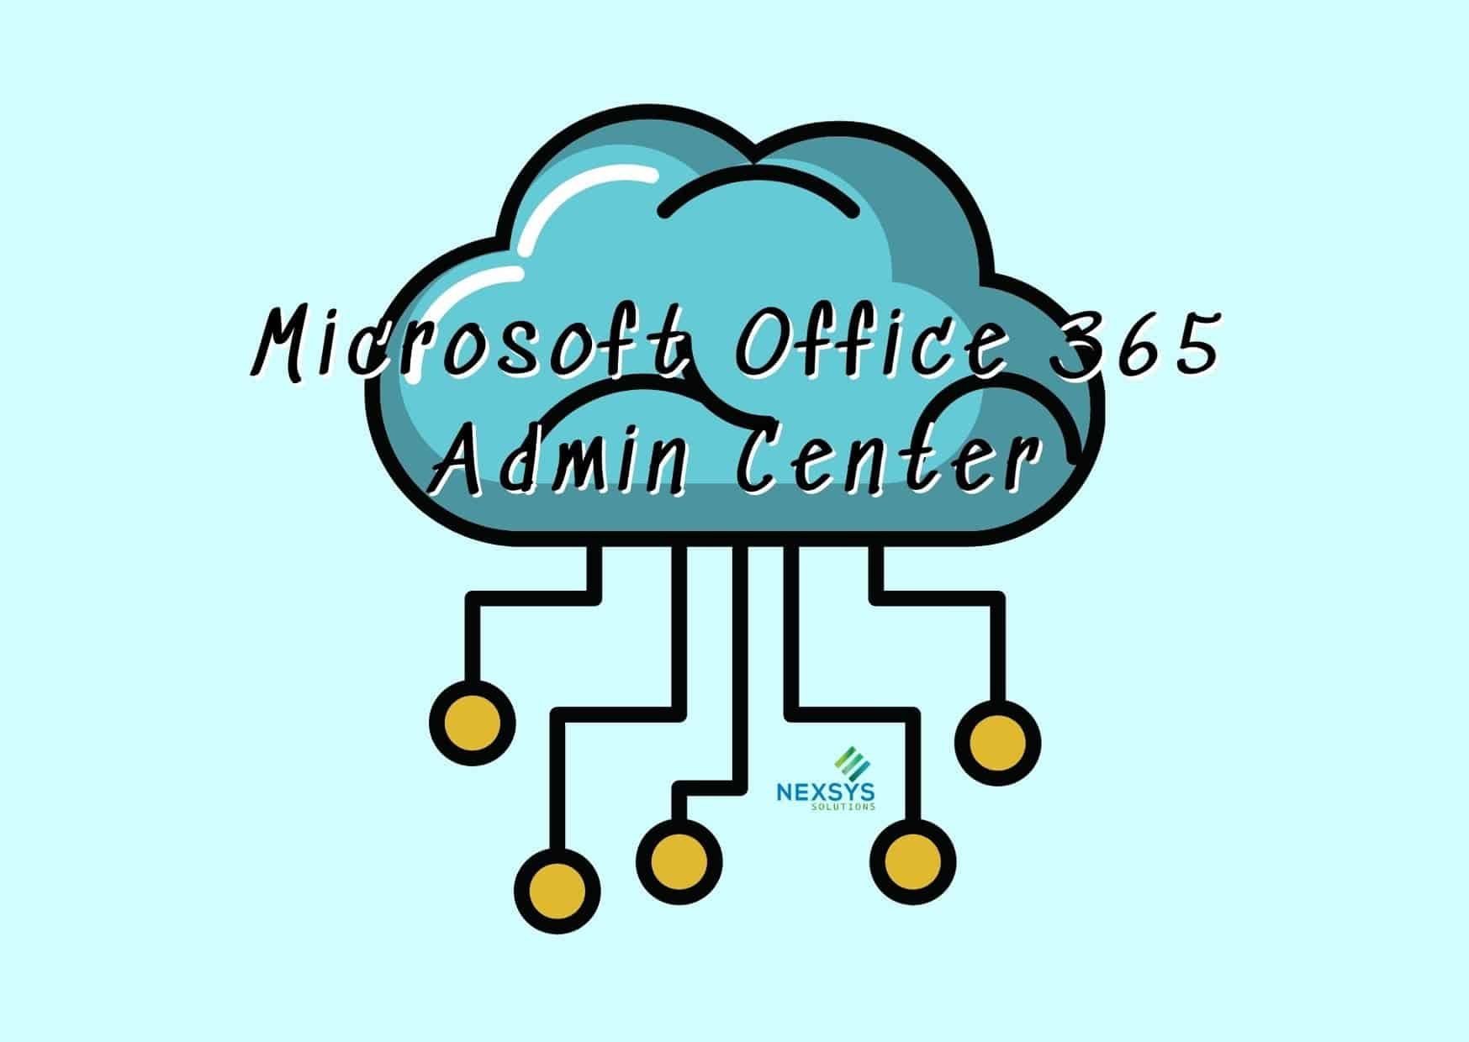

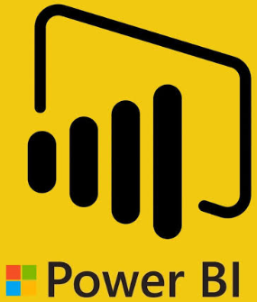
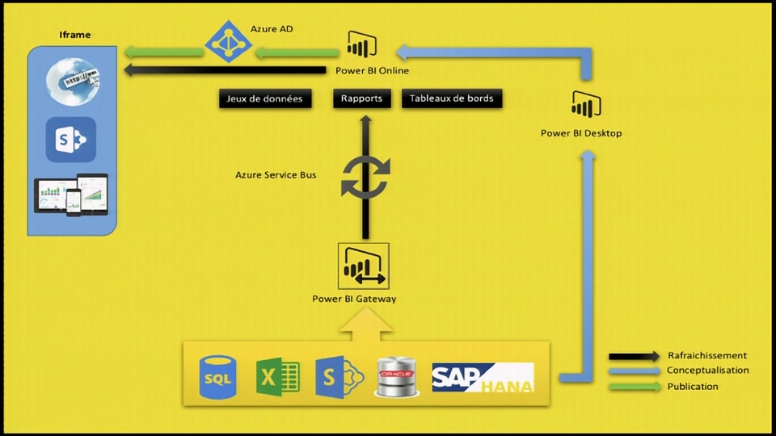
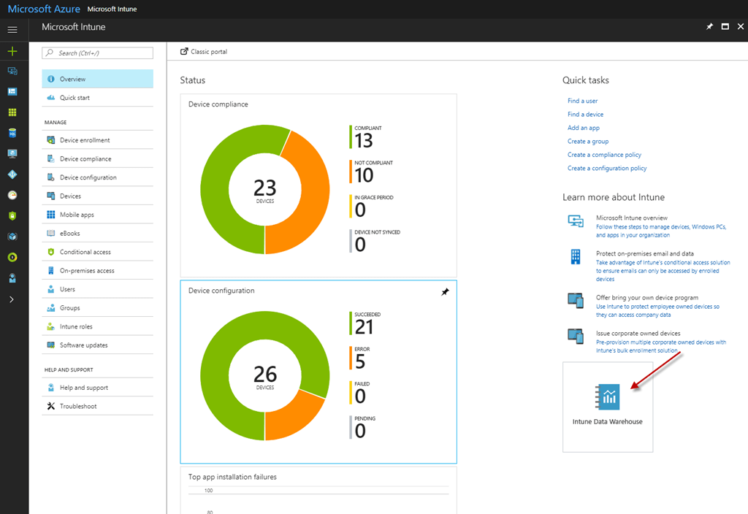
Who is the administrator?
Office365/Azure/AD/PP Admins
Probably your traditional IT Admin teams
Office 365 assigns a user to the Fabic Administrator Role`(and maybe Power Platform Admin)
AAD to Create groups and add users
Azure to allow connecting to Azure Resources
+
Power BI Admins
Best placed with your data team
Review Settings & create corresponding security groups
Setup Gateways & connections & delegate
Assigning user access (Via groups)
Create Workspaces
Clearly some cooperation is required between all of these people, so get everyone on board.
PBI Admin
Gateway and
Connection
Workspaces
5

Slide 4
Demo
8M

Slide 5
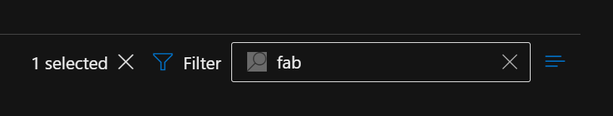
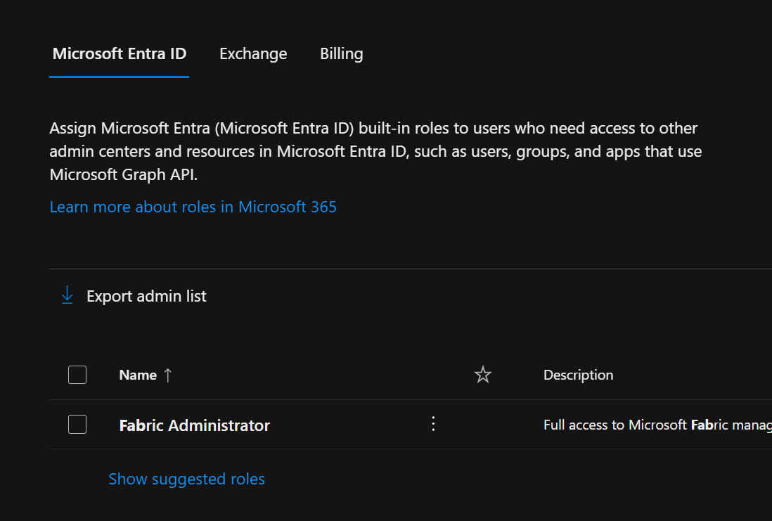
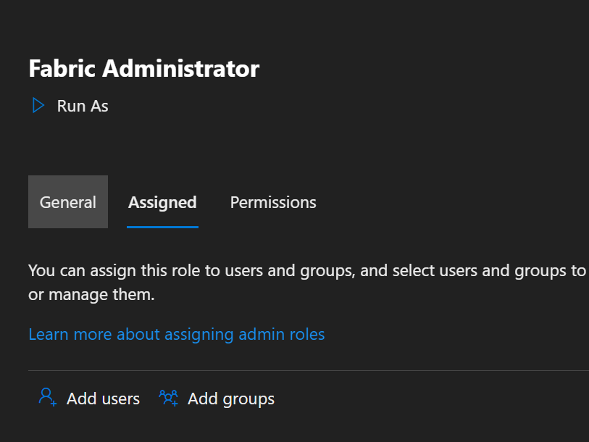
https://admin.microsoft.com/Adminportal/Home#/rbac/directory
Search for Fabric
8M

Slide 6
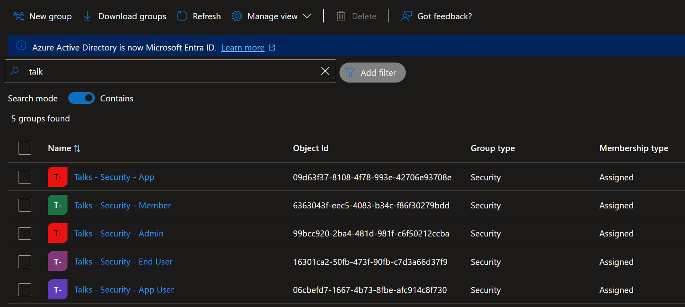
https://portal.azure.com/#view/Microsoft_AAD_IAM/GroupsManagementMenuBlade/~/AllGroups
New Group – Naming Convention
Add Users
8M

Slide 7
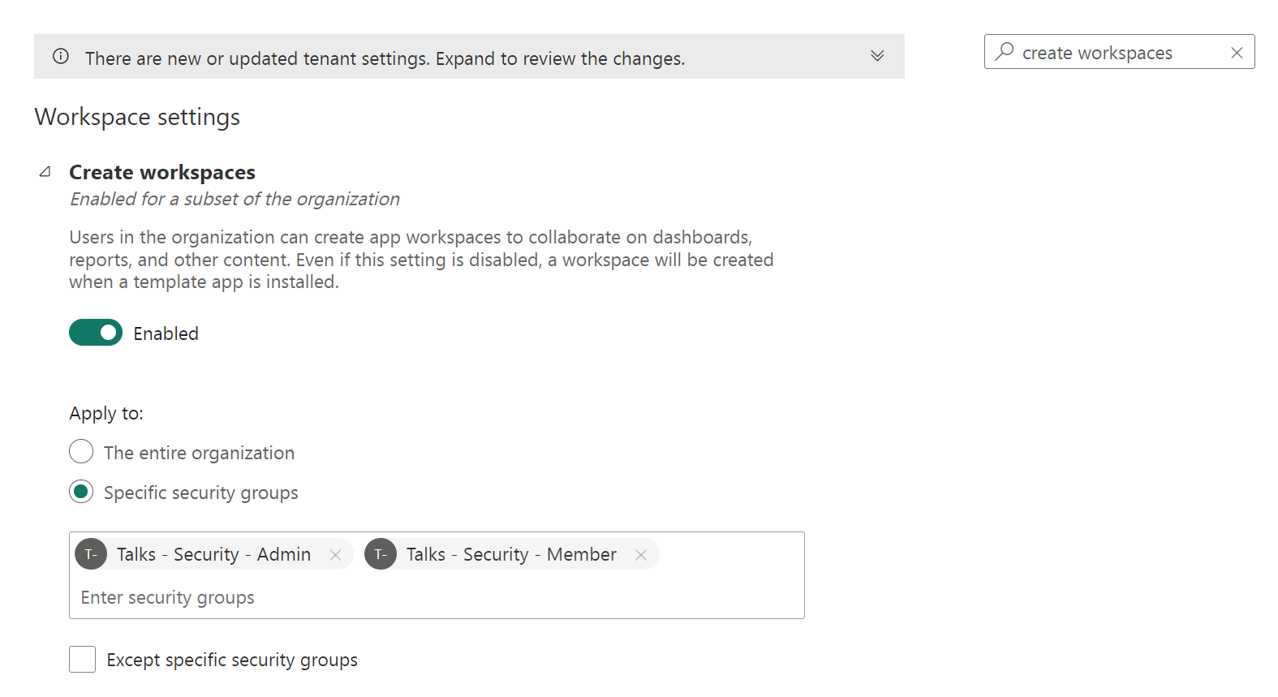
https://app.powerbi.com/admin-portal/tenantSettings?experience=power-bi
Review Settings
Assign Groups
Enable/Disable
8M

Slide 8
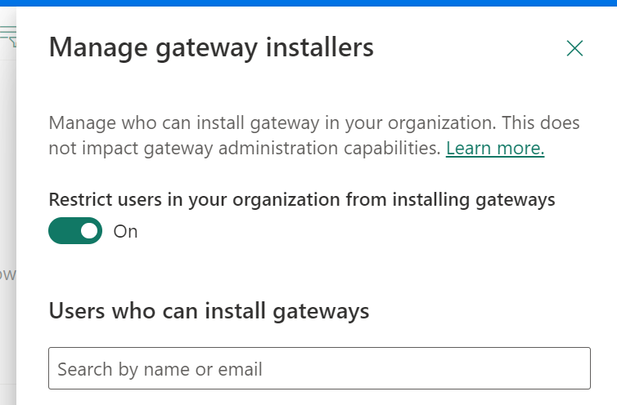
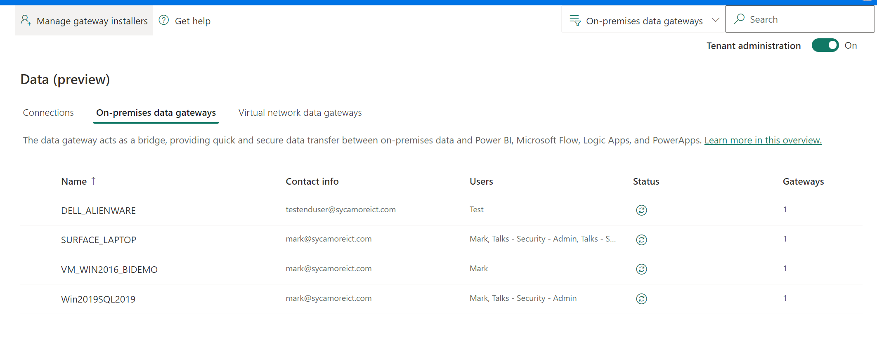
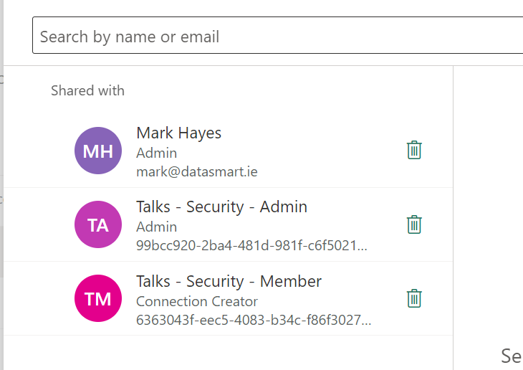
https://app.powerbi.com/groups/me/gateways?experience=power-bi
Select Tenant Admin
Manage Gateway Installers
Assign Groups
8M

Slide 9
Tenant – Know your environment
PBI has a lot of settings (and defaults) that you need to review – 120 the last time I checked
PBI adds new defaults from time to time
Some defaults are questionable – Publish to Web
Some directly impact usability – Cross workspace reports, Excel live
Highlights
Create Workspaces
Semantic Model across workspaces
Export to Excel / Excel Live
Publish to Web
Anything in preview or trial items
Public Internet Access / Conditional Access
Public Sector – Be extra aware of this
Use groups to enable controlled access
Not a huge job here. 1) Review & 2) Repeat at suitable cadence

Slide 10
Demo
12

Slide 11
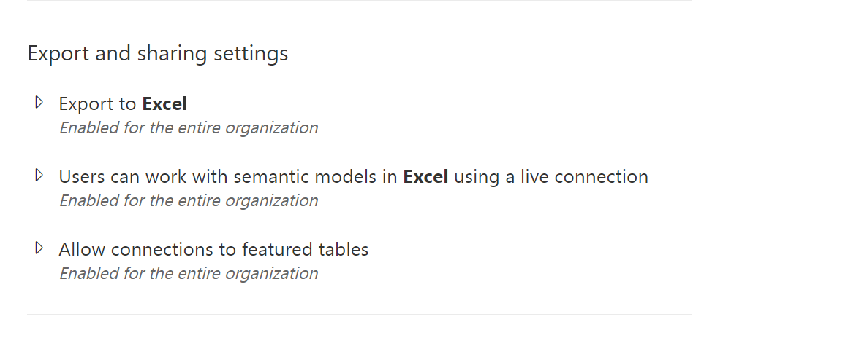
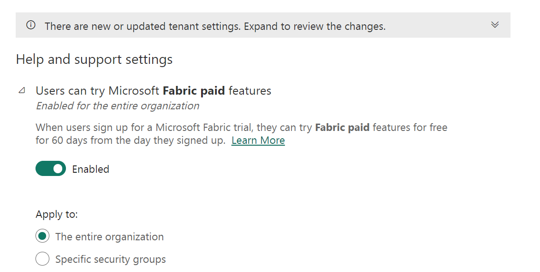
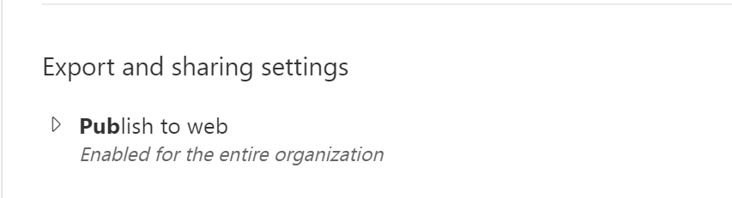
https://app.powerbi.com/admin-portal/tenantSettings?experience=power-bi
Fabric Paid
Excel
Publish to Web
8M

Slide 12
Publish To Web
https://app.powerbi.com/admin-portal/embedCodes?experience=power-bi
Web Search for
site:app.powerbi.com "Number of Sessions attended“
8M

Slide 13
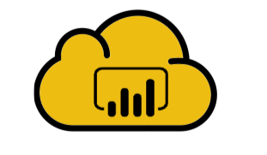
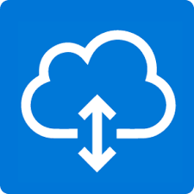

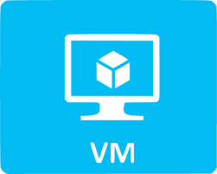

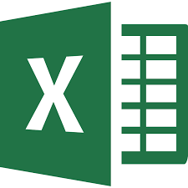

Gateways and Data Connections
Connections
This is infrastructure to allow the PBI Service to connect to on-premise data, but on it’s own, it doesn’t have any level of access to any data.
Security points
The VM and its connectivity to your network
User who installs the gateway
User who registers the gateway to the PBI Service
Gateway Admin
Service Account of the gateway

Slide 14
Gateways and Data Connections
Gateways are created by the user who registers, who become the initial gateway admin. You can restrict this to specific users. (Not a group)
Gateway runs as a service – Service account does not need any particular permissions, and the service account is not what accesses any on premise DB.
The service, typically runs on a VM, which needs to have IP connectivity to any on premise source. I.e. Firewall Rules. Harden this VM as appropriate
VM needs to have drivers to relevant sources.
Multiple Gateways can exist in one tenant, and they could be linked to different domains.
If I register your gateway, while I could register another gateway from a different domain/device, that does not give me access to your domain from the new domain. It just means that there is a new gateway available

Slide 15
Gateways and Data Connections
Connections can source from Cloud, Gateway or VNET
Once a connection exists, it can be linked to a Model, assuming the user configuring has rights to use the connection.
By using Security Groups, you can reduce connection sprawl
Connections can use a variety of authentication methods. Be aware of impact of a particular method on your model
Sharing a connection with access to more tables than the model need, does not mean end users get see more than they should.

Slide 16
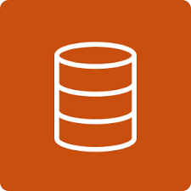

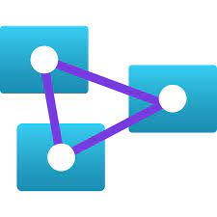
Connection Type
John
Jane
Import
srv_admin_edwh
srv_admin_edwh
EDWH
End user Security Here
Sales
John
Jane
Direct Query
srv_admin_edwh
Sales
srv_admin_edwh
EDWH
End user Security Here
John
Jane
Direct Query / SSO + Kerberos
John / Jane
Sales
srv_admin_edwh
EDWH
End user Security Here
End user Security Here
John
Jane
Live
srv_admin_live
srv_admin_edwh
+ John / Jane
(effective user name)
Sales +
srv_admin_live
Sales +
EDWH
End user Security Here
22

Slide 17
Demo
12

Slide 18
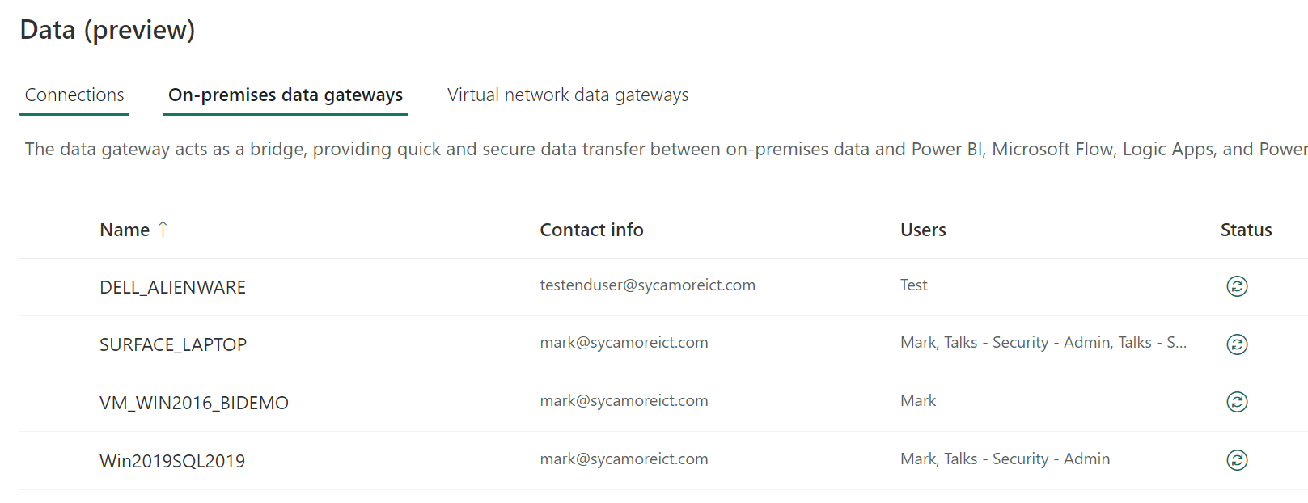
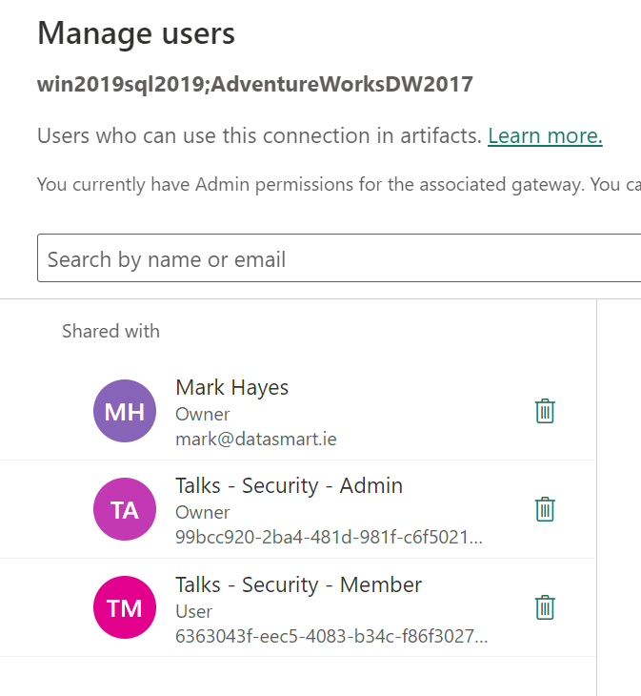
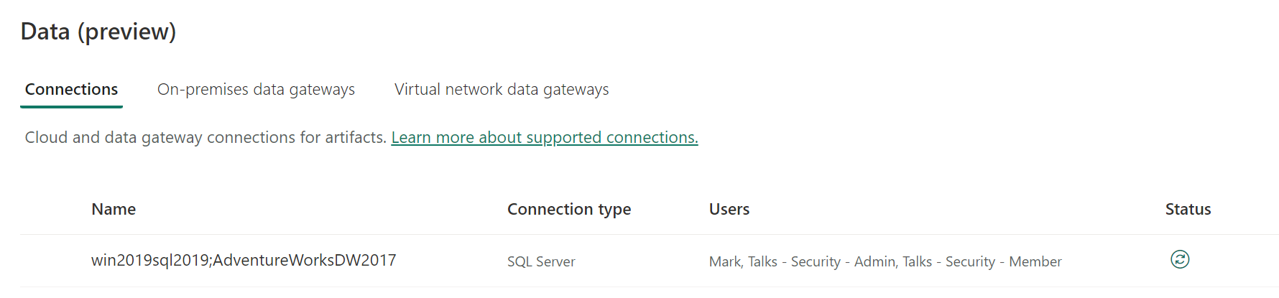
https://app.powerbi.com/groups/me/gateways?experience=power-bi
25

Slide 19
Workspaces and Workspace Apps
Four Roles, Admin, Member, Contributor & Viewers
Admin – Only applies to that Workspace (and a tenant admin does not automatically have access to a workspace)
Member & Contributor – Similar Roles
Differences around Apps, sharing, adding lower privilege users
Can create objects. I.e. Reports, i.e. Clutter
Viewer – The least privilege role, and the only one that RLS & OLS applies to
When adding users, apply least privilege necessary. I.e. Viewer -> Contributor -> Member -> Admin
Create security groups for all. Add users to Security groups
This may mean that you need a way of efficiently adding a user to a security group -> Expect Push back, from IT and Users

Slide 20
Workspaces and Workspace Apps
Workspaces can get cluttered
Apps allow you to publish a sanitised view of your workspace
One app per workspace, but Audience profiles allow further segmentation
Security Groups to segment your Audiences
Publishing an app does not give access to a to a workspace but does give access to models within that workspace.
It does not give access to a dataset with RLS.

Slide 21
Workspaces – Cross Workspace Access
What if you have a workspace, that is highly governed, so all members are by default in the viewer role, but you want to allow users to create their own reports?
Allows you to highly govern one workspace, while allowing users the ability to create and share reports that access governed data in a lower governed workspace
If a lot of push back, can be a reasonable compromise on how to balance wildfire of users adding other users to workspaces. I.e. Governed = Groups and lower governed = named users
There is a tenant setting that allows this.
By default, a viewer can’t do this, unless the model is shared to a security group with permissions to build content

Slide 22





Possible Setup
Governed
Security Groups
Majority are Viewers
Power Users are Members/Contributors
Semi Governed
Security Groups
Majority are Members/Contributors
RLS/OLS Model
Groups per role
Groups are members of Workspace Group
Build Permission Allowed
Reports from Governed workspace
User created
User Managed
Full Access Model
Team Model
User Created - Managed
Reports “Gold”
New Reports
Majority User – App
32

Slide 23
Demo
36

Slide 24
Securing the data model
Workspace security works on an all or nothing basis. Contributors, Members and Admin see everything, and just vary on privilege
Viewers can be locked down
By default, they don’t see any datasets, but they can run reports that access them
Reduce what they see in a model – Row Level Security & Object Level Security
Remove ability to access a model - RLS
OLS & RLS allows a single model to serve multiple users, (both internal and external)
Groups again play a significant role
One group type to identify the “type” of user.
Optional – Additional groups to associate a user with what data they see

Slide 25
Securing the data model – OLS and RLS
OLS (Object Level Security)
Denies access to Columns and/or tables
I.e. Jane cannot see anything to do with Cost
NB – Impact on measures (and visuals) that depend on Cost
RLS (Row Level Security)
Allows access to row level data on tables
i.e. Jane can only see data associated with her territory
RLS can propagate to other tables, but consider the performance impact
You can have multiple RLS filters to different table, but allow for the overlap of data
NB - Impact on measures that measure relative to total.
40

Slide 26
Demo
45

Slide 27
Wrap up
Appoint your administrator and understand the relationships between different admins
Use Security Groups for access to features, workspaces, admins, gateways etc. Try to align with existing security groups.
Review your tenant setting and make this a reoccurring admin job
Apply least privilege
Adopt a pattern that you want to apply as a template to workspaces/app/reports around security
Admins/Members/contributors of workspaces, need to be aware of the privilege they have.
Beware side effects on RLS and OLS on perceived usability.

Slide 28
Avoiding Turbulent Skies: Power BI Security Strategies for a Smooth Flight
@MarkDataGuy
../in/markhayes/
datasmart.ie
Thank you
50

Slide 29
The Tyranny of sharing
When a report is shared, the receiving user has access to the data, even if they don’t have access to the workspace.
At the time of sharing, unless resharing is disabled, then that report can be shared to many more user
While the tenant setting for sharing makes you think you can restrict this, it only reduces the scope.
Methods to prevent/Reduce
Use RLS (even for full access) – However this only applies to viewers
Use Apps as the only way to access reports – But workspace members still have access to the reports
Change the Tenant Setting (but be aware of what it actually does)
Training members to be aware of risk of sharing and disable this option
Monitor

Slide 30
Semi Planned v Planned adoption of PowerBI
Semi planned - Often PBI just appears, people starting using it, and beyond a Licence (which could be trial), there isn’t too much discussion around governance and security.
Get Desktop
Create Model
Get Licence
Create Workspace
Publish Model
Share
Planned Adoption
Who is Admin
Tenant Setting Review
Setup Gateways
Setup up connection governance
Create Workspaces – Assign Admin & issue guidance & create security admin group
Develop
Share via Apps

